Slide 1
How to Succeed in Capstone
Arushri Swarup
October 5, 2016

Slide 2
In General
Constant communication with group, client, professors, TA
Always ask questions/seek help if you are stuck
Meet with Professor and Client as they give different perspectives
Productive meetings (split up the work)
Take breaks!

Slide 3
My Project
Developing Tools for Endoscopic Ear Surgery
Client: Dr. Adrian James, ENT
Problem: Endoscopic ear surgery is single-handed
In ear drum reconstruction, a graft is placed on the ear drum. Rosen needle used to impale the graft but hard to take out.
Solution: tool that combines a two-handed maneuver
Designed a ‘graft pusher mechanism’

Slide 4
Constraints: time, resources and money
Medical device development requires time and money
Made a modification to an existing tool
Did not reinvent the wheel
Used connections/resources currently available at SickKids and U of T
Asked for advice – TA, Prof and Vito Forte

Slide 5
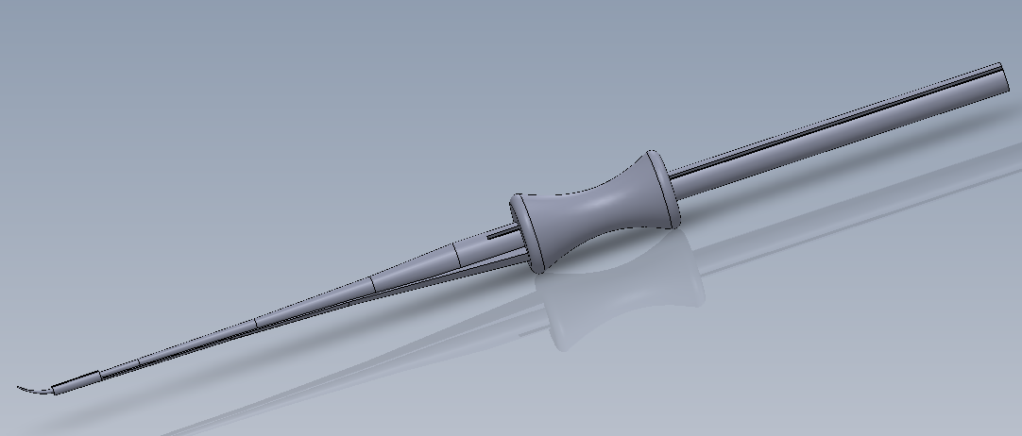
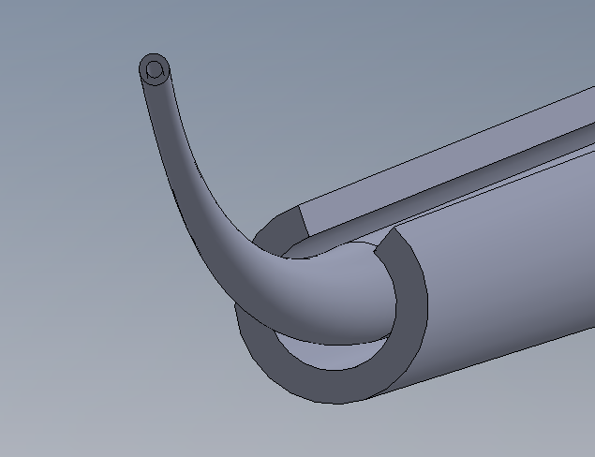

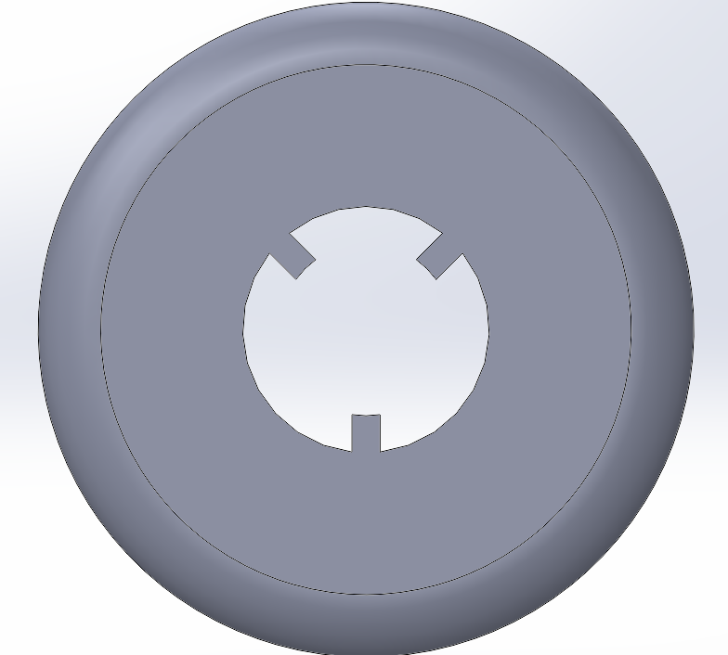
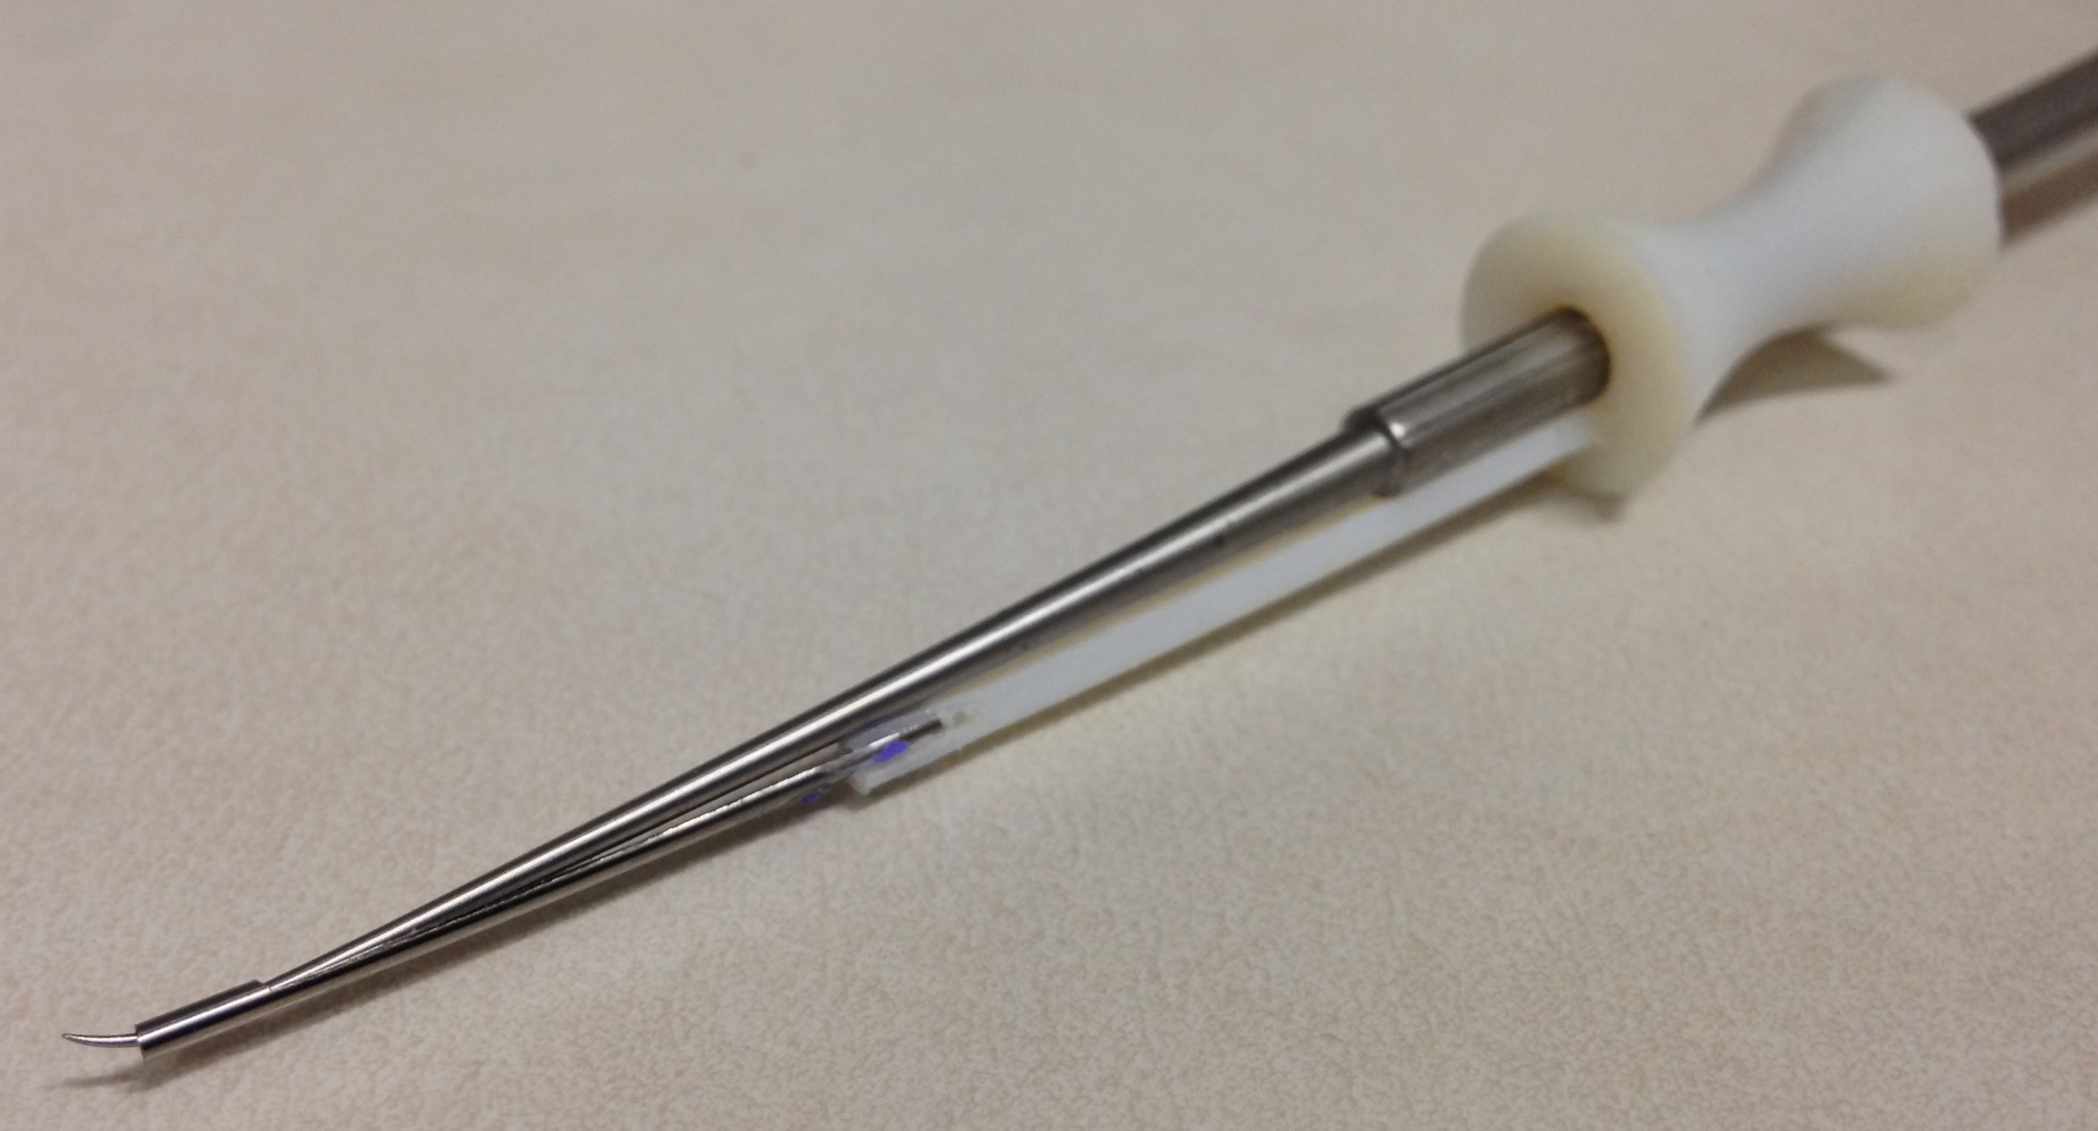
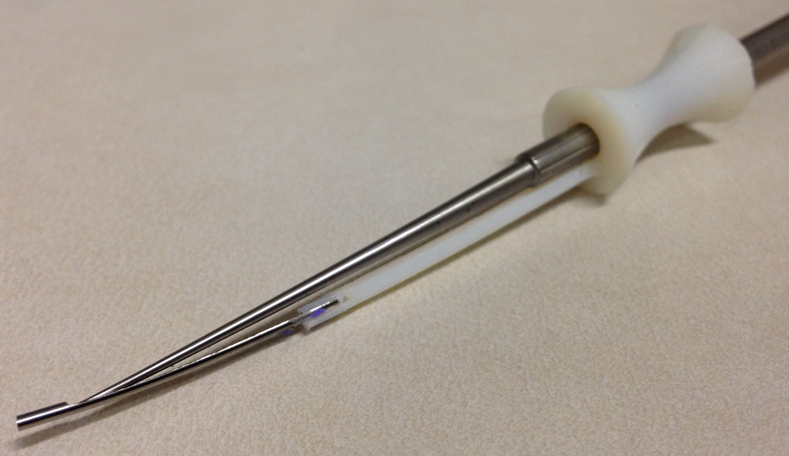
Elliptical-shaped suction tip
GRAFT REMOVAL MECHANISM
HANDLE
Sheath
Cross Section of Handle with Grooves to integrate with notches (in slider)
Groove in Handle
Cross Section of Slider with notches to integrate with grooves (in handle)
TIP
Slider
Thin Rod
3D Computer Model
Physical Prototype
Metal Pusher Tip Withdrawn Position
Metal Pusher Tip Advanced Position
Rosen Needle
Slider
Sheath
Rod

